Slide 1
Food & Energy
HMS 7th Grade Science

Slide 2
Nutrients
Body converts the food you eat into 6 kinds of nutrients
Carbohydrates
Fats
Proteins
Vitamins
Minerals
Water

Slide 3
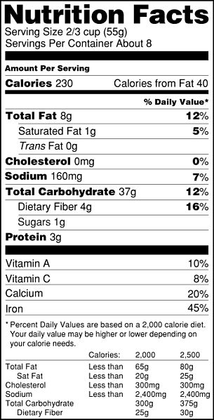
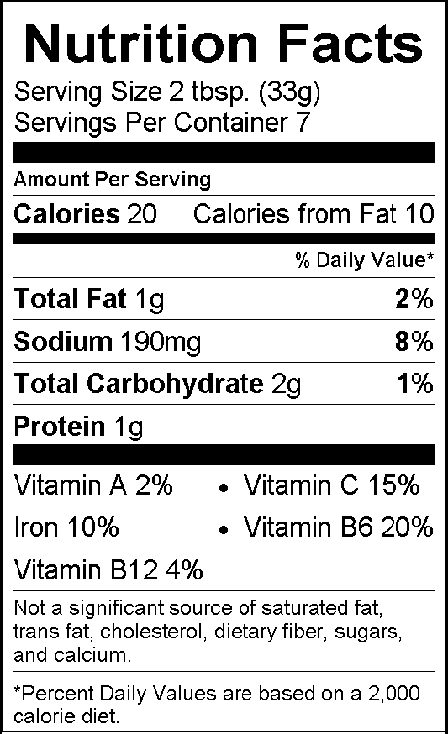
Calories
Amount of energy needed to raise the temperature of one liter of water by one Celsius degree = 1 Calorie
Nutrition Labels

Slide 4
Carbohydrates
Composed of carbon, oxygen and hydrogen
Major source of energy
One gram equals 4 Calories
Chemical structure divides into 2 groups: simple (sugar) and complex (starch and fiber)
Body converts the carbohydrates into glucose (a form of sugar used for energy)

Slide 5
Fats
High energy nutrients
Composed of carbon, oxygen and hydrogen
Contain more than twice as much energy as an equal amount of carbohydrates (1g fat = 9 Calories)
Form part of the structure of cells
Fatty tissue protects and supports your internal organs
Fatty tissue acts as insulation to keep heat inside and cushion your body
Classified as unsaturated, saturated, and trans-

Slide 6
Proteins
Nutrients that contain nitrogen, carbon, hydrogen and oxygen
Needed for tissue growth and repair
Can be used for energy, usually not
Broken down into smaller units called amino acids
Group into complete (animals) and incomplete (plants)

Slide 7
Vitamins
Helper molecule in a variety of chemical reactions in the body
Either fat soluble or water soluble

Slide 8
Minerals
Nutrients that are not made by living things
Obtain minerals by eating plant foods or animals that have eaten plants.

Slide 9
Water
Most important nutrient due to the body’s vital processes
Chemical reactions, such as the breakdown of nutrients, take place in water.
Under normal conditions you should consume 2 liters of water every day.

